Slide 1


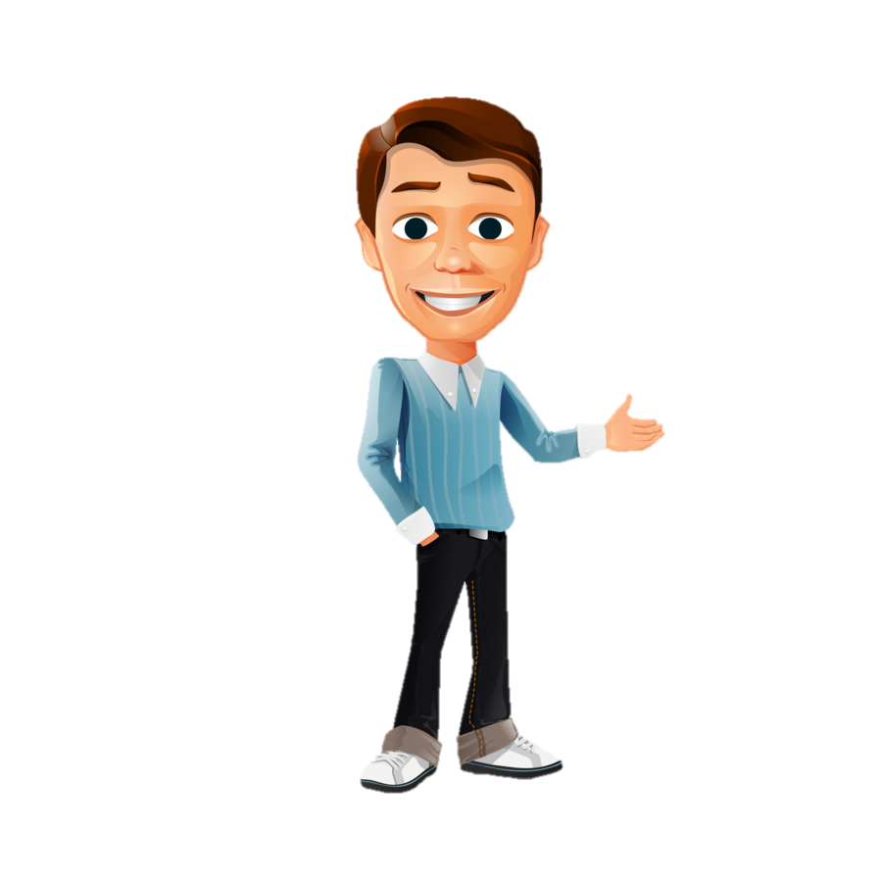

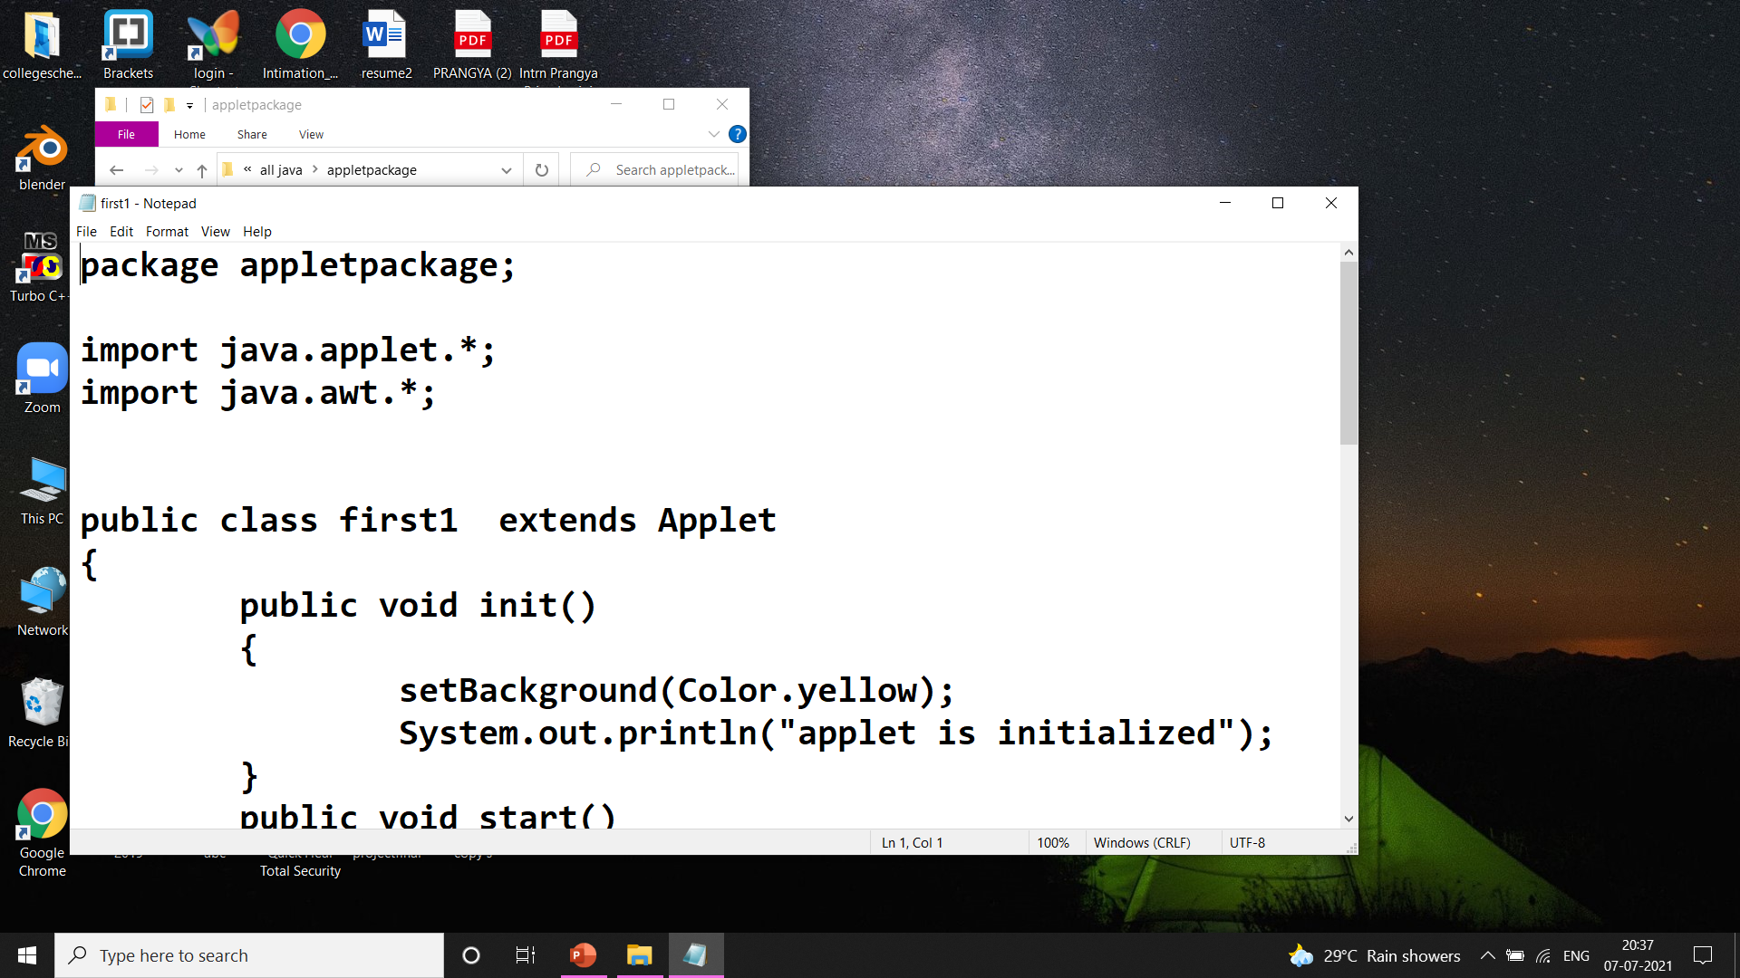


BOOK
SOFTWARE
CHAPTERS
PROGRAM
AS SAME AS
“We need to bring android and chrome to every screen that matters foe users, which is why we focused on phone, wearables, cars, television, laptops and even your workspace.”
LINES
STATEMENT
“We need to bring android and chrome to every screen that matters foe users, which is why we focused on phone, wearables, cars, television, laptops and even your workspace.”
public
WORDS
TOKEN

Slide 2
do, while, let, const etc.
Keywords
Literals
55, “hyy”, true
<variable Name>
Function name
Tokens
Identifiers
Special symbol
#,$,%,& etc.
Operators
+,-,/,*etc.

Slide 3


Keywords are:
Keywords
await
break
case
catch
class
const
continue
debugger
default
delete
Do
else
switch
static
this
throw
try
true
typeof
var
void
while
with
yield
enum
export
extends
false
finally
for
function
if
implements
import
in
instanceof
interface
let
new
null
package
private
protected
public
return
super
These are the reserve word whose having fixed meaning in programming language…..

Slide 4

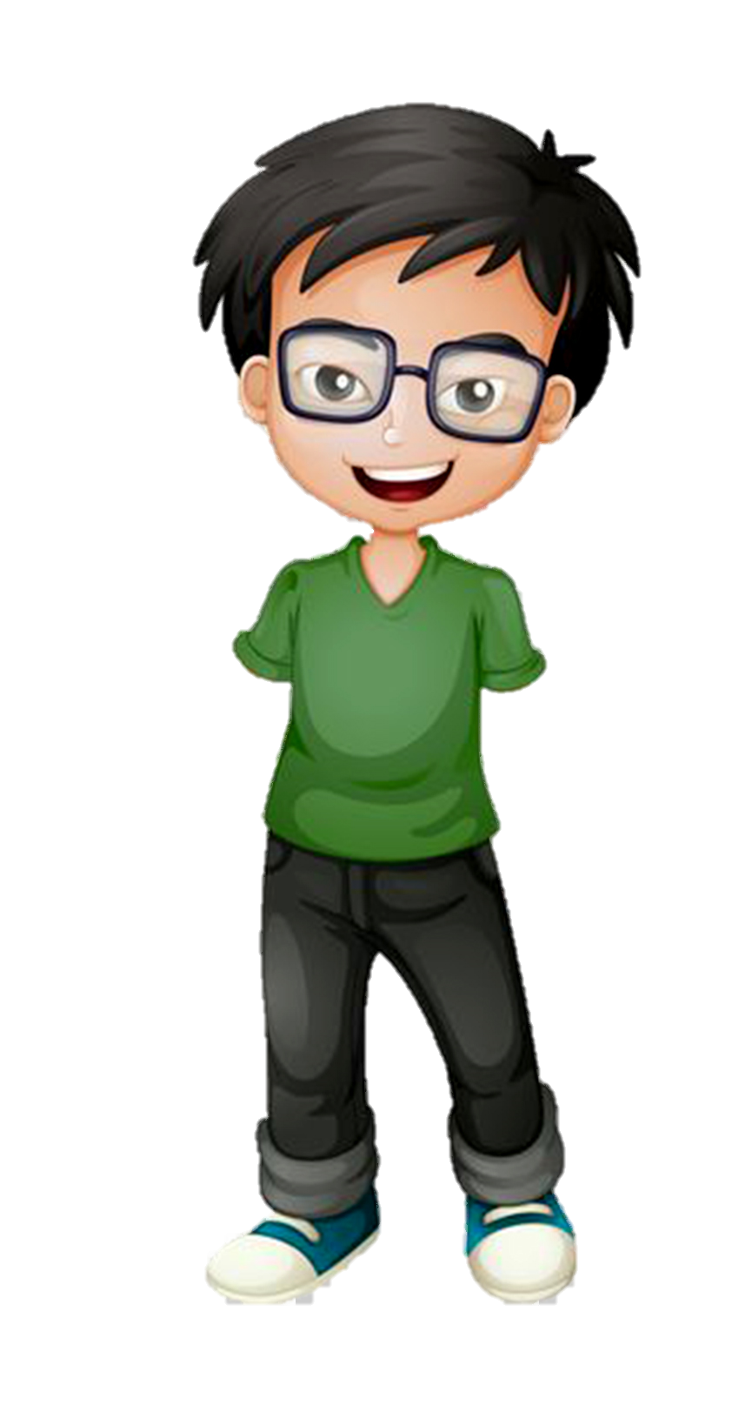
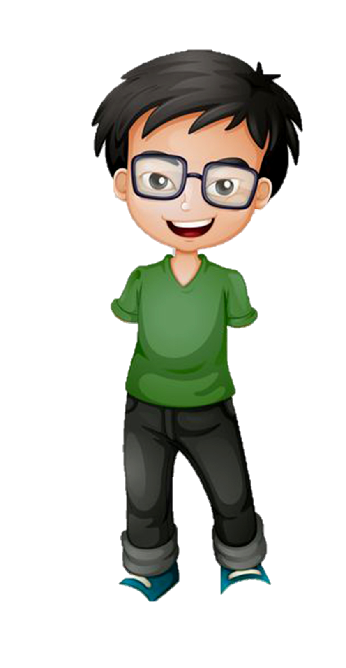
MESSAGE
Sonu
H
http://video,mxplayer
H
thanks
SEND
Q
W
E
R
T
Y
U
I
O
P
A
S
D
F
G
H
J
K
L
Z
X
C
V
B
N
M
SPACE

Slide 5
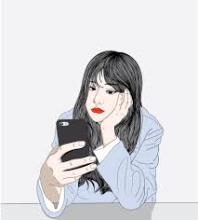

Sonu
I want to download this link but its not working, why???
It says there is no proper app to open this link!!!
Yehhh!!
its working properly
Now I will enjoy it..
After download the Mx player

Slide 6


Here the point is:
You may not have proper app for viewing this contained.

